Slide 1


Learning Python Fundamentals
Beginners level
March 2025
Sindhu k Pillai
Technical architect in data engineering | specialized in Snowflake/aiml/Gen AI
15+ years in IT industry
Notes:
Welcome to our session on Learning Python Fundamentals, a beginner-friendly dive into the world of coding.
I’m Sindhu K Pillai, a Technical Architect in the Data Engineering space. Over the years, I’ve worked with organizations like Infosys and Hexaware, specializing in Snowflake, and have mastered my skills in AIML and Generative AI. With 15+ years of industry experience, I’m here to make Python simple and fun for you. Let’s get started!

Slide 2
About Complete Course
Beginners Level
Intermediate Level
Advanced Level
6 Hands-On Project (2 per level)
2 Capstone Project
Target Audience Group: 13+ years
Notes:
Alright, here’s how the course is structured: we’ve got three levels—Beginners, Intermediate, and Advanced—to help you gradually build your skills and pace yourself through this coding journey. At the end of each level, you’ll work on two projects to put your learning into action. And to wrap things up, there’ll be two big capstone projects where you’ll apply everything you’ve learned so far. That’s a total of 8 projects!

Slide 3
Beginners Course - Day Planner
Introduction to Python
What is Python?
Datatypes + Operators
Variables
Control Flows
Statements
Data Structures
Lists
Functions
Function Calling
Environmental Setup
Sample Hello World Program
Operators:
Arithmetic
Comparison
Logical
Loops
Break, continue and pass
Tuples
Dictionaries
Parameters
Default and Keyword arguments
Hands On Project
Simple Calculator
Guess the number Game
If, Elif, else
For, while
Return values
Constants
Data Types
Sets
Arrays
Notes:
Python Explained for Kids | What is Python Coding Language? | Why Python is So Popular?
Here’s the plan for the Beginners Course, spread across 6 days:
Day 1: We’ll kick things off by learning what Python is, set up the environment, and wrap up with a simple “Hello, World!” program.
Day 2: We’ll dive deeper into data types and operators to understand how they work.
Day 3: It’s all about control flows—getting the hang of if, for, and while conditions.
Day 4: We’ll explore data structures and how to use them effectively.
Day 5: It’s function time! We’ll learn how to create and use functions.
Day 6: Time to put it all together with some hands-on projects!
Don’t stress if this all sounds a bit overwhelming right now. We’ll take it one step at a time, and it’ll all start making sense as we go along
So, without further delay, let’s dive right in and get started!

Slide 4
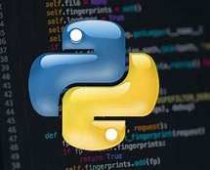
What is Python?
Python is a friendly programming language
Open source
Highly interpreted
Easy to code and understand
Think of Python like a magic pen. You write instructions, and the computer follows them to do cool things like solving puzzles, drawing pictures, or even making games!
Python-like programming languages include C, C++, Ruby, Java, JavaScript, R, PHP, Go, Perl etc..
Notes:
Here are we.
Before we get started, let me ask you something—are you excited to learn some new skills?
Great to hear your response! Now, I wasn’t trying to test you or anything. I just wanted to highlight something interesting. See what happened here? I asked you a question in a language, which you understood it, and responded back.
That’s pretty much how Python works too!
It’s a programming language to communicate with a machine which takes the inputs you give, translates them into machine language (because that’s what computers understand), executes the code in the order you’ve written, and gives you the desired output. Hope you got it, right?

Slide 5
Installation & Environmental Setup
Installation
Setting up the environment
Visit the official Python website: https://www.python.org/
Download the latest version of Python for your operating system.
Run the installer and ensure you check the box to "Add Python to PATH".
Use an Integrated Development Environment (IDE) like PyCharm, VS Code, or IDLE.
Alternatively, use an online platform like Google Colab or Jupyter Notebook.
For this program, Ignore all -we will use the free online platform – Google Colab,
All you need is a Gmail Account for Sign In
Notes:
Introduction to Google Colab
Google Colab (short for Colaboratory) is a free, cloud-based platform by Google that allows you to write and execute Python code in an interactive environment. It is especially useful for beginners, data scientists, and machine learning enthusiasts.
Key Features of Google Colab
Free to Use: No installation required; runs in your browser.
Cloud-Based: Your work is saved online, and you can access it from anywhere.
Supports Python: Pre-installed libraries like NumPy, pandas, TensorFlow, and more.
Free GPUs and TPUs: Ideal for machine learning and deep learning projects.
Collaboration: Share and work on notebooks with others in real-time.
Why Use Google Colab?
No Setup Needed: Start coding immediately without installing Python or Jupyter.
Beginner-Friendly: Simple interface for first-time users.
Powerful Hardware: Access to free GPUs/TPUs for heavy computations.
Integrated with Google Drive: Save and manage your files easily.
How to Get Started
Open Google Colab: Go to https://colab.research.google.com.
Create a New Notebook: Click on "New Notebook" to start coding.
Write Code in Cells: Use code cells for Python and text cells for explanations.
Run Code: Press Shift + Enter to execute a code cell.
Basic Tips for First-Time Users
Add Text or Code: Use the "+" button to add cells.
Run Code: Highlight a cell and press Shift + Enter.
Save Work: Save your notebook to Google Drive (File > Save a copy in Drive).
Use Hardware Accelerators: Enable GPUs/TPUs (Runtime > Change runtime type).

Slide 6
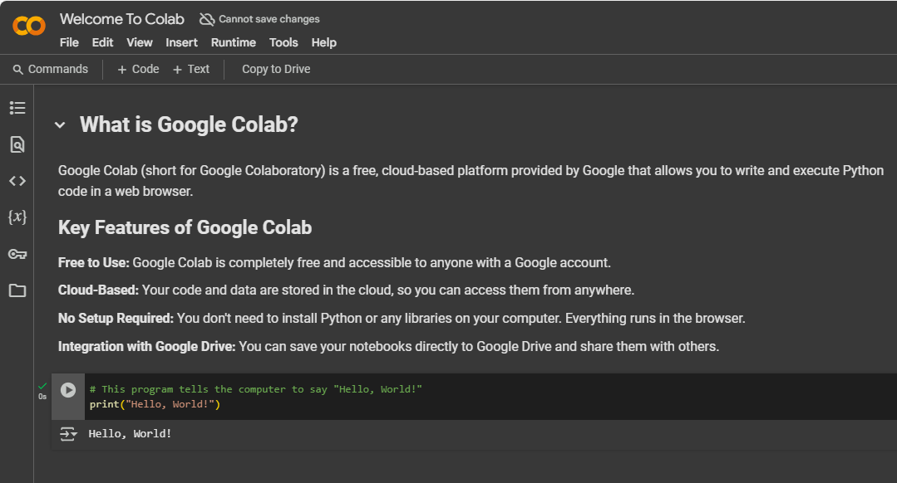
Sample Hello World Program
Open your Google Colab
Sign in with your Gmail Account
Click New Notebook
Write the code provided.
# This program tells the computer to say "Hello, World!"
print("Hello, World!")
Run the program to see the output.

Slide 7
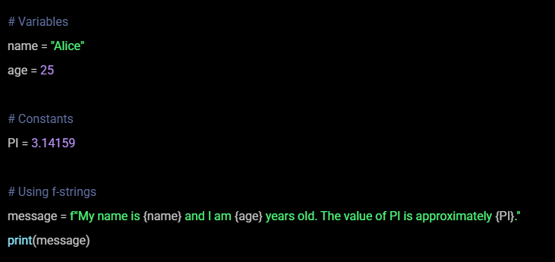
Variables & Constants
Variables in Python are used to store data that can change during program execution.
Constants are values that remain fixed throughout the program.
Assigned using equal to (=) operator
Notes:
# Variables
name = "Alice"
age = 25
# Constants
PI = 3.14159
# Using f-strings
message = f"My name is {name} and I am {age} years old. The value of PI is approximately {PI}."
print(message)

Slide 8
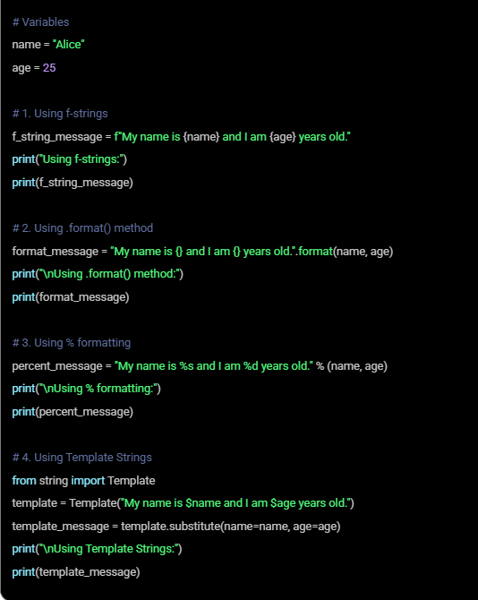
String Formatting
Create dynamic and readable strings
Using f-strings
Using .format() method
Using % formatting
Using Templates
Notes:
# Variables
name = "Alice"
age = 25
# 1. Using f-strings
f_string_message = f"My name is {name} and I am {age} years old."
print("Using f-strings:")
print(f_string_message)
# 2. Using .format() method
format_message = "My name is {} and I am {} years old.".format(name, age)
print("\nUsing .format() method:")
print(format_message)
# 3. Using % formatting
percent_message = "My name is %s and I am %d years old." % (name, age)
print("\nUsing % formatting:")
print(percent_message)
# 4. Using Template Strings
from string import Template
template = Template("My name is $name and I am $age years old.")
template_message = template.substitute(name=name, age=age)
print("\nUsing Template Strings:")
print(template_message)

Slide 9
Naming Conventions
Aspect | Variables | Constants
Case | Lowercase | Uppercase
Case Sensitive | case-sensitive | case-sensitive
Word Separation | Use underscores (full_name) | Use underscores (PI_VALUE)
Descriptive Names | Should be meaningful and descriptive | Should be meaningful and descriptive
Starting Character | Must start with a letter or underscore | Must start with a letter or underscore
Reserved Keywords | Avoid using Python reserved keywords | Avoid using Python reserved keywords
Special Characters | No special characters like @, $, % | No special characters like @, $, %
Placement | Defined within code blocks or functions | Defined at the module level (top of the file)

Slide 10
Python Syntax
Python Indentation Refers to the spaces at the beginning of a code line.
Python uses indentation to indicate a block of code will be covered later.
Cannot use Indentation for readability purpose.
Comments can be used to make the code more readable.
Comments can be used to prevent the code execution.
Single line comment starts with a Hash tag (#)
Multi-line comments are enclosed within triple quotations
# This is a single line comment “”” This is a
multiline comment
“””
Notes:
“””

Slide 11
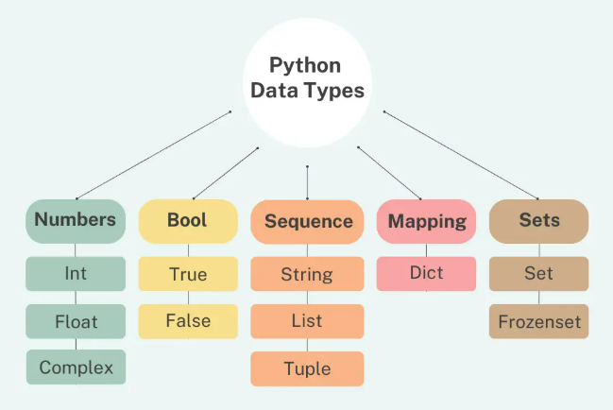
Data Types
Data types define the kind of value a variable can hold.
Python is dynamically typed, meaning you don't need to specify the type explicitly.

Slide 12
Data Types
Data Type | Example | Description | Mutable/Immutable
int | age = 25 | Whole numbers | Immutable
float | pi = 3.14 | Decimal numbers | Immutable
complex | complex_num = 2 + 3j | Numbers with real and imaginary parts | Immutable
str | name = "Alice" | Text or sequence of characters | Immutable
bool | is_student = True | True or False values | Immutable
list | hobbies = [“reading", “dancing"] | Ordered, mutable collection of items | Mutable
tuple | coordinates = (10, 20) | Ordered, immutable collection of items | Immutable
dict | person = {"name": "Alice"} | Key-value pairs | Mutable
Set | unique_numbers = {1, 2, 3} | Unordered collection of unique items | Mutable
Frozenset | immutable_set = frozenset([1, 2, 3]) | Set that cannot be modified | Immutable
Notes:
# Python Data Types Demonstration
# Numeric Types
print("### Numeric Types ###")
int_var = 25 # Integer
print(f"Integer: {int_var} (Type: {type(int_var)})")
float_var = 19.99 # Float
print(f"Float: {float_var} (Type: {type(float_var)})")
complex_var = 3 + 5j # Complex
print(f"Complex: {complex_var} (Type: {type(complex_var)})")
# Text Type
print("\n### Text Type ###")
str_var = "Hello, Python!" # String
print(f"String: {str_var} (Type: {type(str_var)})")
# Sequence Types
print("\n### Sequence Types ###")
list_var = ["apple", "banana", "cherry"] # List
print(f"List: {list_var} (Type: {type(list_var)})")
tuple_var = (10, 20, 30) # Tuple
print(f"Tuple: {tuple_var} (Type: {type(tuple_var)})")
# Mapping Type
print("\n### Mapping Type ###")
dict_var = {"name": "Alice", "age": 25} # Dictionary
print(f"Dictionary: {dict_var} (Type: {type(dict_var)})")
# Set Types
print("\n### Set Types ###")
set_var = {1, 2, 3, 3} # Set
print(f"Set: {set_var} (Type: {type(set_var)})")
frozenset_var = frozenset([1, 2, 3]) # Frozenset
print(f"Frozenset: {frozenset_var} (Type: {type(frozenset_var)})")
# Boolean Type
print("\n### Boolean Type ###")
bool_var = True # Boolean
print(f"Boolean: {bool_var} (Type: {type(bool_var)})")
# Special Data Type
print("\n### Special Data Type ###")
none_var = None # NoneType
print(f"NoneType: {none_var} (Type: {type(none_var)})")
# Summary
print("\n### Summary ###")
print("This script covers all major Python data types:")
print("Numeric, Text, Sequence, Mapping, Set, Boolean, and NoneType.")

Slide 13
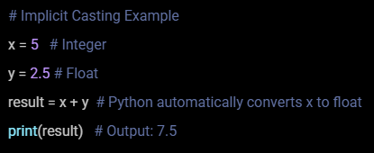
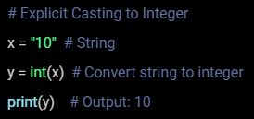
Python Casting
Python casting refers to converting one data type to another.
Python provides built-in functions for casting.
Types of Casting in Python
Implicit Casting – Automatic conversion Explicit Casting – Manual Conversion
Notes:
# Example to understand Python casting (implicit and explicit) with types
# Implicit Casting (Python automatically handles type conversion)
# Integer to float (implicit)
int_value = 10
float_value = int_value + 3.5 # Adding integer and float results in implicit conversion to float
print(f"Implicit Casting: Integer {int_value} + Float 3.5 = {float_value} (Type: {type(float_value)})")
# Explicit Casting (Manually converting types)
# Integer to float (explicit)
int_value = 10
float_value = float(int_value)
print(f"Explicit Casting: Integer {int_value} casted to float: {float_value} (Type: {type(float_value)})")
# Float to integer (explicit)
float_value = 10.75
int_value = int(float_value)
print(f"Explicit Casting: Float {float_value} casted to integer: {int_value} (Type: {type(int_value)})")
# Integer to string (explicit)
int_value = 25
str_value = str(int_value)
print(f"Explicit Casting: Integer {int_value} casted to string: '{str_value}' (Type: {type(str_value)})")
# String to integer (explicit)
str_value = "100"
int_value = int(str_value)
print(f"Explicit Casting: String '{str_value}' casted to integer: {int_value} (Type: {type(int_value)})")
# String to float (explicit)
str_value = "123.45"
float_value = float(str_value)
print(f"Explicit Casting: String '{str_value}' casted to float: {float_value} (Type: {type(float_value)})")
# Float to string (explicit)
float_value = 56.78
str_value = str(float_value)
print(f"Explicit Casting: Float {float_value} casted to string: '{str_value}' (Type: {type(str_value)})")
# Implicit Casting in expressions
# Combining integer and float in arithmetic operation
num1 = 5 # Integer
num2 = 2.5 # Float
result = num1 * num2 # Implicitly casted to float
print(f"Implicit Casting: Integer {num1} * Float {num2} = {result} (Type: {type(result)})")

Slide 14
String Operations
Category | Operation | Method/Example | Sample Output
Basic Operations | Concatenation | str1 + str2 | "Hello" + "World" → "HelloWorld"
 | Repetition | str * n | "Python" * 3 → "PythonPythonPython"
 | Slicing | string[start:end] | "Programming"[0:5] → "Progr"
 | Length | len(string) | len("Python") → 6
Case Conversion | Convert to Uppercase | string.upper() | "hello".upper() → "HELLO"
 | Convert to Lowercase | string.lower() | "HELLO".lower() → "hello"
 | Convert to Title Case | string.title() | "hello world".title() → "Hello World"
Search and Replace | Check if Starts/Ends with Substring | string.startswith(substring) / string.endswith(substring) | "Python".startswith("Py") → True
 | Find Substring | string.find(substring) | "Python is fun".find("is") → 7
 | Replace Substring | string.replace(old, new) | "I love Python".replace("Python", "coding") → "I love coding"
Splitting and Joining | Split a String | string.split(separator) | "apple,banana".split(",") → ['apple', 'banana']
 | Join a List of Strings | separator.join(list) | " ".join(["Python", "is", "fun"]) → "Python is fun"
Trimming | Strip Whitespace | string.strip() | " Hello ".strip() → "Hello"
Character Checks | Check Alphanumeric | string.isalnum() | "Python123".isalnum() → True
 | Check Alphabetic | string.isalpha() | "Python".isalpha() → True
 | Check Digits | string.isdigit() | "12345".isdigit() → True
Counting | Count Occurrences of Substring | string.count(substring) | "Python Python".count("Python") → 2
String Formatting | Format Strings Dynamically | f"My name is {name}" or string.format() | f"My name is Alice" → "My name is Alice"
Notes:
# Example codes for various operations on Python Strings
# 1. Concatenation
str1 = "Hello"
str2 = "World"
result = str1 + " " + str2
print(f"Concatenation: {result}")
# 2. Repetition
str3 = "Python"
result = str3 * 3
print(f"Repetition: {result}")
# 3. Slicing
str4 = "Programming"
result = str4[0:5] # Extracting 'Progr'
print(f"Slicing: {result}")
# 4. Length of a string
str5 = "Learning Python"
length = len(str5)
print(f"Length: {length}")
# 5. String case conversion
str6 = "hello world"
print(f"Uppercase: {str6.upper()}")
print(f"Lowercase: {str6.lower()}")
print(f"Title Case: {str6.title()}")
# 6. Checking if a string starts or ends with a specific substring
str7 = "Python Programming"
print(f"Starts with 'Python': {str7.startswith('Python')}")
print(f"Ends with 'Programming': {str7.endswith('Programming')}")
# 7. Finding a substring
str8 = "Python is fun"
index = str8.find("is")
print(f"Index of 'is': {index}")
# 8. Replace a substring
str9 = "I love Python"
result = str9.replace("Python", "coding")
print(f"Replace: {result}")
# 9. Splitting a string
str10 = "apple,banana,cherry"
result = str10.split(",")
print(f"Split: {result}")
# 10. Joining strings
list_of_strings = ["Python", "is", "awesome"]
result = " ".join(list_of_strings)
print(f"Join: {result}")
# 11. Stripping whitespace
str11 = " Hello Python "
print(f"Strip: '{str11.strip()}'")
# 12. Checking for alphanumeric characters
str12 = "Python123"
print(f"Is Alphanumeric: {str12.isalnum()}")
# 13. Checking for alphabetic characters
str13 = "Python"
print(f"Is Alphabetic: {str13.isalpha()}")
# 14. Checking for digits
str14 = "12345"
print(f"Is Digit: {str14.isdigit()}")
# 15. Counting occurrences of a substring
str15 = "Python is fun and Python is powerful"
count = str15.count("Python")
print(f"Count of 'Python': {count}")
# 16. String formatting
name = "Alice"
age = 25
result = f"My name is {name} and I am {age} years old."
print(f"String Formatting: {result}")

Slide 15
Escape Characters
Format strings for better readability.
Include special characters like quotes within strings.
Add whitespace (e.g., tabs, newlines) for structured output.
Escape Character | Description | Example Code | Output
\n | Newline | print("Hello\nWorld") | Hello<br>World
\t | Tab | print("Hello\tWorld") | Hello World
\\ | Backslash | print("This is a backslash: \\") | This is a backslash: \
\' | Single Quote | print('It\'s Python') | It's Python
\" | Double Quote | print("He said \"Hello\"") | He said "Hello"
\r | Carriage Return | print("Hello\rWorld") | World
\b | Backspace | print("Hello\bWorld") | HellWorld
\f | Form Feed | print("Hello\fWorld") | Hello (form feed) World
\v | Vertical Tab | print("Hello\vWorld") | Hello (vertical tab) World
Notes:
newline_example = "Hello\nWorld" print(f"Newline: {newline_example}")
tab_example = "Hello\tWorld" print(f"Tab: {tab_example}")
backslash_example = "This is a backslash: \\" print(f"Backslash: {backslash_example}")
single_quote_example = 'It\'s Python' print(f"Single Quote: {single_quote_example}")
double_quote_example = "He said \"Hello\"" print(f"Double Quote: {double_quote_example}")
carriage_return_example = "Hello\rWorld" print(f"Carriage Return: {carriage_return_example}")
backspace_example = "Hello\bWorld" print(f"Backspace: {backspace_example}")
form_feed_example = "Hello\fWorld" print(f"Form Feed: {form_feed_example}")
vertical_tab_example = "Hello\vWorld" print(f"Vertical Tab: {vertical_tab_example}")

Slide 16
Python Operators
Python operators are special symbols or keywords.
Perform operations on variables and values.
Basic Python Operators
Arithmetic Operators
Comparison Operators
Logical Operators

Slide 17
Arithmetic Operations
Used to perform mathematical operations.
Operator | Description | Example Code | Output
+ | Addition | print(5 + 3) | 8
- | Subtraction | print(5 - 3) | 2
* | Multiplication | print(5 * 3) | 15
/ | Division | print(5 / 3) | 1.6667
% | Modulus (Remainder) | print(5 % 3) | 2
** | Exponentiation | print(5 ** 3) | 125
// | Floor Division | print(5 // 3) | 1
Notes:
# Arithmetic Operators
a = 10
b = 3
# Addition: Adds two numbers
print(f"Addition: {a + b}") # Output: 13
# Subtraction: Subtracts the second number from the first
print(f"Subtraction: {a - b}") # Output: 7
# Multiplication: Multiplies two numbers
print(f"Multiplication: {a * b}") # Output: 30
# Division: Divides the first number by the second (returns float)
print(f"Division: {a / b}") # Output: 3.3333333333333335
# Modulus: Returns the remainder of the division
print(f"Modulus: {a % b}") # Output: 1
# Exponentiation: Raises the first number to the power of the second
print(f"Exponentiation: {a ** b}") # Output: 1000
# Floor Division: Divides and truncates the decimal part
print(f"Floor Division: {a // b}") # Output: 3

Slide 18
Comparison Operators
Used to compare two values and return a Boolean result.
Operator | Description | Example Code | Output
== | Equal to | print(5 == 3) | False
!= | Not equal to | print(5 != 3) | True
> | Greater than | print(5 > 3) | True
< | Less than | print(5 < 3) | False
>= | Greater than or equal | print(5 >= 3) | True
<= | Less than or equal | print(5 <= 3) | False
Notes:
# Comparison Operators
x = 15
y = 10
# Equal to: Checks if two values are equal
print(f"Equal to: {x == y}") # Output: False
# Not equal to: Checks if two values are not equal
print(f"Not equal to: {x != y}") # Output: True
# Greater than: Checks if the first value is greater than the second
print(f"Greater than: {x > y}") # Output: True
# Less than: Checks if the first value is less than the second
print(f"Less than: {x < y}") # Output: False
# Greater than or equal to: Checks if the first value is greater than or equal to the second
print(f"Greater than or equal to: {x >= y}") # Output: True
# Less than or equal to: Checks if the first value is less than or equal to the second
print(f"Less than or equal to: {x <= y}") # Output: False

Slide 19
Logical Operators
Used to combine conditional statements.
Operator | Description | Example Code | Output
and | Logical AND | print(True and False) | False
or | Logical OR | print(True or False) | True
not | Logical NOT | print(not True) | False
Notes:
# Logical Operators
a = True
b = False
# Logical AND: Returns True if both conditions are True
print(f"Logical AND: {a and b}") # Output: False
# Logical OR: Returns True if at least one condition is True
print(f"Logical OR: {a or b}") # Output: True
# Logical NOT: Reverses the boolean value
print(f"Logical NOT (of a): {not a}") # Output: False
print(f"Logical NOT (of b): {not b}") # Output: True

Slide 20
Day 1 Summary
Understood Python Overview
Understood the Env. Set up
Successful coding on first python code

Slide 21
Thank you
Questions?

